Slide 1


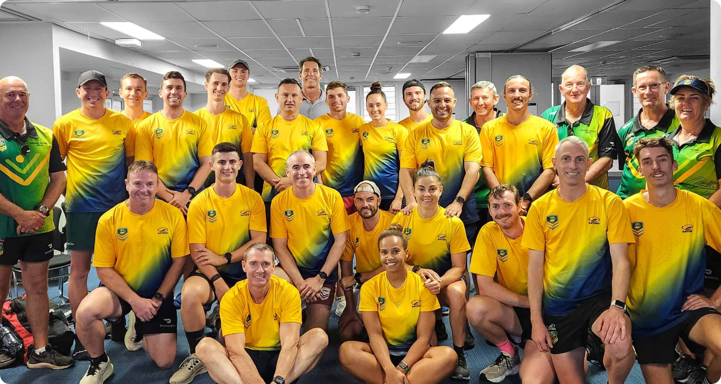



Touch Football Australia: A Strategic Vision for 2026-2029
This presentation delineates the comprehensive strategic blueprint designed for Touch Football Australia, focused on establishing the organization as a global leader in the non-contact sports arena through increased participation, digital advancements, and enhanced community inclusion initiatives.
Damian Wainohu
GM - Growth & Innovation Candidate

Slide 2








Vision, Mission & Guiding Principles of Touch Football Australia
Empowering communities through inclusive and sustainable touch football practices.
1
2
3
4
People First
Digital by Design
Inclusion as a Standard
Sustainable & Accountable
Empower individuals across all touchpoints: players, volunteers, coaches, referees, administrators.
Build a tech-driven future with cutting-edge tools, real-time insights, and immersive experiences.
Embed cultural respect, accessibility, gender equity, and community co-design in all operations.
Lead environmental action, transparent governance, and rigorous evaluation.

Slide 3





Enhancing Participation in Touch Football 2026–2029
Strategic framework for increasing engagement and inclusivity in junior team sports across Australia
Current Participation
1
Touch Football has over 600,000 participants with significant gains in junior programs and female engagement.
Growth Target
2
Aim to increase participation to 755,000 players by 2029, focusing on schools and diverse cohorts.
Action Plan
3
Implement a 'school-first' engagement model to enhance partnerships and participation rates effectively.
Expected Results
4
Anticipate a 40% increase in junior girls and a 15% increase in female referee and coach accreditations.

Slide 4

SWOT Analysis of Workforce Development in Touch Football
Evaluating Strengths, Weaknesses, Opportunities, and Threats
Strengths
Weaknesses
Passionate volunteer and part-time workforce dedicated to Touch Football.
Inconsistent support reported in many regions impacting overall effectiveness.
Opportunities
Threats
National workforce model to significantly increase female/CALD participation in leadership.
Potential lack of resources for training and support could hinder workforce development.

Slide 5









Enhancing Digital Transformation in Touch Football Australia
Establishing an integrated digital ecosystem for player engagement and administration efficiency
Vision Statement: Innovate digital sport ecosystem
Current Situation: Need for integration
Action Plan: Deploy Touch Tech by 2027
Expected Result: Improved user engagement
To position Touch Football Australia as the leading digital sports organization through innovative practices and technologies.
TFA has initiated digital engagement but must enhance player experience with a fully integrated digital ecosystem.
A SMART goal to launch the Touch Tech Digital Innovation Platform, ensuring broad CRM adoption among users by the target timeline.
Creation of an interactive digital infrastructure that simplifies administrative tasks and fosters greater player involvement and satisfaction.

Slide 6















KPI 4: Enhancing Community and Cultural Identity in Touch Football
Establishing a framework for inclusive sporting environments from 2026 to 2029
Inclusive Sporting Environments
Diverse Participation Growth
Inclusion360 Framework
State Inclusion Panels
Community Connection Strengthening
Setting a national and international benchmark for inclusivity in Touch Football programs.
Touch Football has seen diverse participation but requires stronger systemic inclusion efforts.
Launching the Inclusion360 Framework by 2026 to embed inclusion in all programs and policies.
Activating State Inclusion Panels to ensure effective activation of the inclusion strategy and community engagement.
Aligning with ASC priorities to enhance community connection and increase representation in leadership roles.

Slide 7


Strategic 30-60-90 Day Action Plan
A structured approach to build relationships and drive early wins for Touch Football Australia
Systematize Growth
Pilot Programs
Establish structures for innovation and growth.
Implement early wins and initiate new programs.
Listening Phase
Focus on relationship building and aligning with stakeholders.

Slide 8




Strategic Partner Engagement & Commercial Growth Plan
Enhancing Touch Football Australia's partner network to achieve commercial objectives.
Vision: Transform TFA’s partner network into a connected ecosystem.
This vision aims to integrate partners into a cohesive framework that enhances collaboration and synergy.
Commercial Objective: Double sponsorship income to $5M+ by FY2029.
Aiming to significantly increase revenue streams through enhanced sponsorship engagement and strategic partnerships.
Key Initiative: Launch the Touch Business Network™.
This initiative focuses on creating a dedicated network for business partnerships that drive engagement and growth.
Strategy: Implement Data-Driven Impact Reporting.
Utilizing data analytics to measure and report the impact, ensuring transparency and effectiveness in partnerships.

Slide 9


Financial Sustainability Roadmap (2026–2029)
Exploring Revenue Strategies and Financial Management Priorities for Growth
Core Revenue Streams
Targets
Participation Fees
$3.8M to $5.5M
Sponsorship & Partnerships
$2.2M to $5M+
Government Grants
$1.5M to $2.75M
Digital & Fan Subscriptions
<$250K to $1.2M
Merchandise
$750K to $1.5M
Education/Workforce Training
$400K to $1.2M

Slide 10








Dynamic Risk Management and Scenario Planning for TFA
Strategies for embedding resilience and proactive risk management into organizational operations
Digital Adoption Lag
Event/Weather Disruption
Conduct tiered rollouts with pilot sites to enhance technology integration.
Develop tiered climate-readiness protocols to mitigate environmental impacts.
Participation Volatility
Cultural Missteps
Implement strategies to maintain low-barrier access for all participants.
Establish a National Cultural Advisory Panel for guidance on cultural issues.

Slide 11







Purpose
Define Measurable Outcomes
1
Enhance Accountability
Foster Continuous Improvement
Support Decision Making
Evaluation & Impact Measurement Plan for Strategic Success
Key Evaluation Frameworks
Outcome Mapping
2
KPI Tracking System
Touch Impact Index (TII)
Annual Evaluation Reports
A structured approach to measuring outcomes and impact in strategic activities
Engagement Strategies
Case Study Series
3
External Review & Peer Benchmarking
Stakeholder Participation
Feedback Mechanisms

Slide 12















Governance & Stakeholder Co-Design
Framework for Effective Collaboration and Accountability
Governance Pillars
Transparency
Inclusivity
Accountability
Agility
Strategic Structures
Board Governance Committees
Co-Design Panels
Quarterly Stakeholder Summits
Annual Affiliate Pulse Report
Digital Governance Tools

Slide 13





Appendices: Glossary and Frameworks
Comprehensive Overview of Key Terms and Strategic Resources
Glossary of Key Terms
Strategic Frameworks
References & Resources
STAR KPIs
ASC Sport 2030
Touch Football Australia Website
Strategic, Targeted, Actionable, and Results-driven Key Performance Indicators.
A strategy focusing on the future of sports in Australia.
Visit for more information: https://touchfootball.com.au.
National Participation Strategy
General Manager PD
SMART Goals
Inclusive Sport strategy aiming to enhance participation.
Position Description for the General Manager, Growth & Innovation.
Specific, Measurable, Achievable, Relevant, Time-bound objectives.
TFA Strategic Plan 2021–2024
STAR KPI 2026–2029
CRM
Foundations for Touch Football Australia's growth and development.
Strategic Framework focusing on key performance indicators.
Customer Relationship Management system for managing participant and fan data.
Annual Report 2023–2024
CRM/Digital Case Studies
Performance indicators for the upcoming financial year.
Internal case studies related to CRM and digital partnerships.
TFA
Touch Football Australia.
NSO
National Sporting Organisation.

Slide 14
Join us in shaping the future of Touch Football
Touch Football Australia calls upon all stakeholders to actively participate in this strategic blueprint. Your engagement is essential in fostering innovation, inclusivity, and sustainable growth for Touch Football across Australia and into the future.
Thank you

